Slide 1

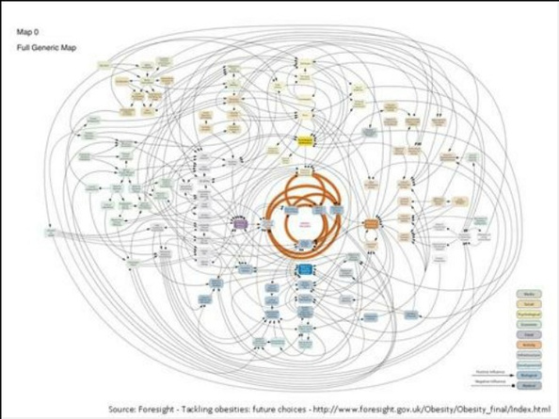


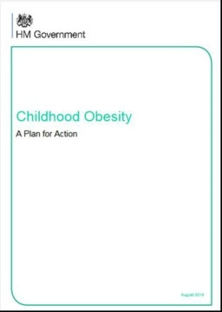
Healthy Weight, Healthy Lives
Childhood Obesity Strategy Tackling Obesity
Afshan Aghili
With thanks to Hilda Mulrooney

Slide 2
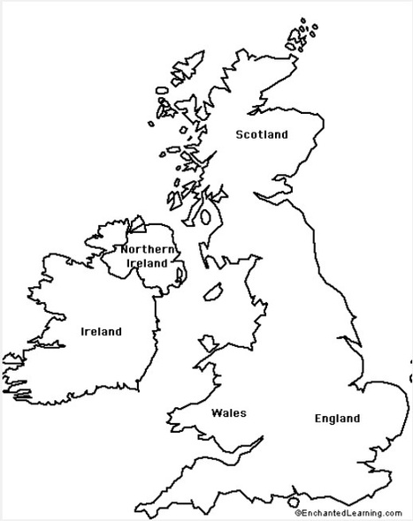
Aims & Objectives
• Review and evaluate
current UK obesity policy
& strategies
• Examine Foresight,
Healthy Weight, Healthy Lives & Childhood Obesity
Strategy reports

Slide 3

Learning Outcomes
• By the end of this session,
students will be able to:
– name the key obesity policy
and strategy documents in England and the UK
– describe the approaches taken
to formulate the Foresight
Report (systems mapping)
– describe the five key strategy
areas of the Healthy Weight Healthy Lives report
– critique current obesity policy in
England and the UK

Slide 4
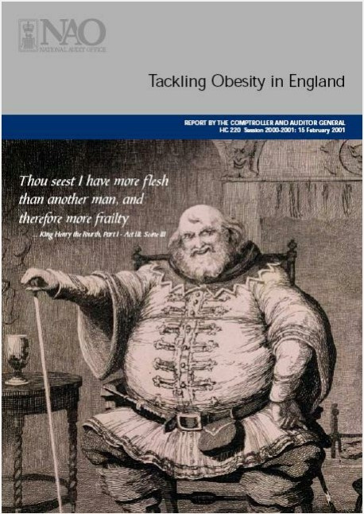

Tackling Obesity in England February 2001
• NAO scrutinises public spending
• Statutory role to report on
economy, efficiency and effectiveness of govt. depts
• Report prepared for House of Commons

Slide 5

Tackling Obesity in England
- main findings and recommendations – cross-govt policy to prevent obesity
•
Build upon existing
partnerships to develop cohesive strategies for prevention
• Establish cross-govt group to
coordinate all research on obesity and its prevention
• Walking and cycling initiatives
and targets
• Targets for sport participation and active leisure pursuits
• School-based physical activity
• Nutrition initiatives with industry
and caterers
• School food

Slide 6


The National Picture
• Government Office for
Science Foresight Programme
• Foresight projects give
evidence to policy-makers to
help them make policies that
are more resilient to the future
• Report published October
2007 – in response to growing
concern over obesity levels
• Foresight – tackling obesities:
future choices
https://assets.publishing.service.gov.uk/media/5a759da7e5274a4368298a4f/07-1184x-tackling-obesities-future-choices-report.pdf

Slide 7
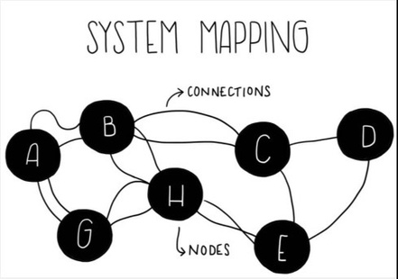
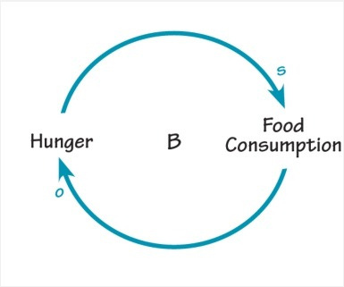
Systems Mapping
• System – structured set of objects/
attributes with relationship between them
• Captures complexity
• Examines relationship between objects & their relative importance
System mapping; process of creating visual tools describing the system & interrelationships within it
Causal loop

Slide 8
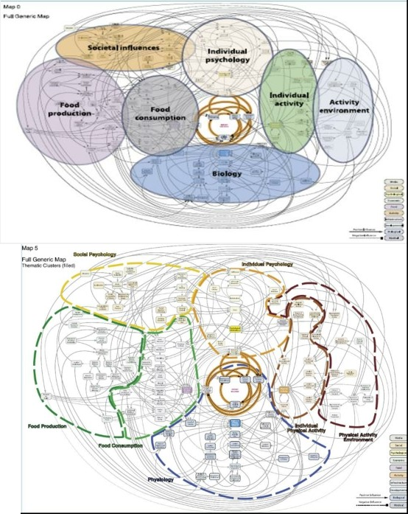
Seven thematic clusters
Biology – genetics, RMR, body
composition
Individual activity – domestic,
work, recreational, transport
Activity environment –
facilitate/obstruct
Food consumption – energy
density, portion size
Food production – growth,
profit, efficiency
Individual psychology – self-
esteem, stress
Societal influences – education,
media, tv viewing

Slide 9

Healthy Weight, Healthy Lives
• Published January 2008
• Govt cross-departmental
strategy to tackle obesity
• Using evidence base and
recommendations from Foresight
• Concise compared with Foresight
https://www.legislation.gov.uk/ukia/2008/9/pdfs/ukia_20080009_en.pdf
Notes:
Funding: £372 million (2008–2011) to promote and maintain healthy weight

Slide 10
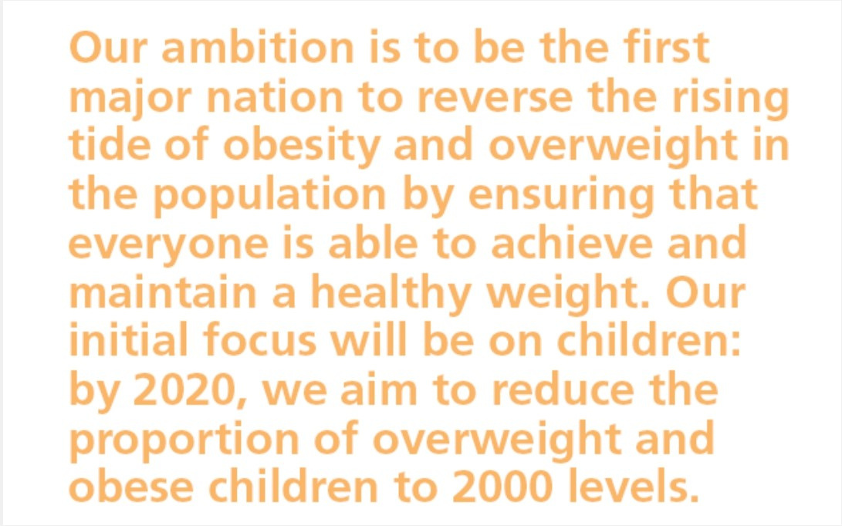
Healthy Weight, Healthy Lives 2008

Slide 11
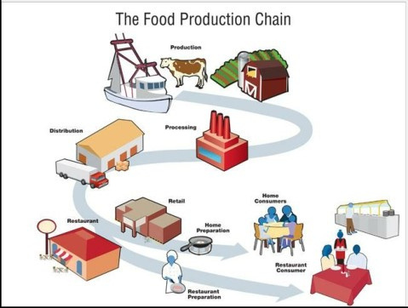
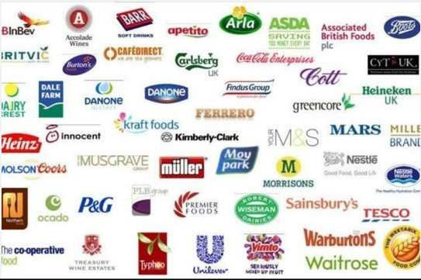
What questions should be considered when devising obesity strategy?
• Should individuals be targeted?
• Should food environment be targeted? (eg retailers,
manufacturers, producers)
• Target all parts of a food system?
• What about the physical environment?

Slide 12

Healthy Weight, Healthy Lives
5 main policy areas. To:
• promote children’s health
• promote healthy food
• build physical activity into
our lives
• promote health at work
• provide effective treatment
and support for those with obesity

Slide 13
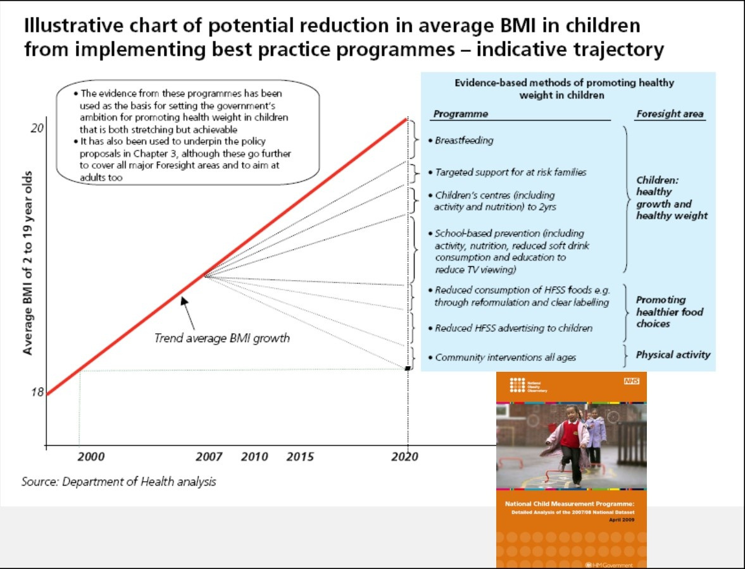
1. To promote children’s health

Slide 14



The National Healthy School Programme
Each London Borough has a
Healthy Schools Coordinator
Food in schools programme
School travel
Physical activity in schools
School meals
https://www.healthyschools.org.uk/

Slide 15
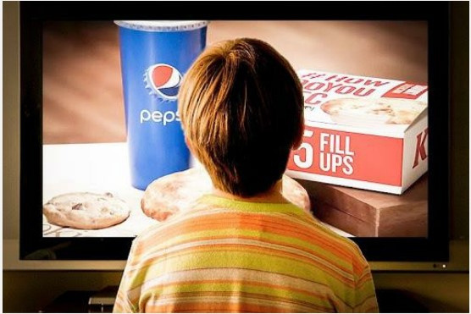

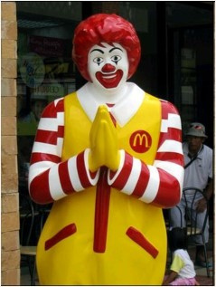
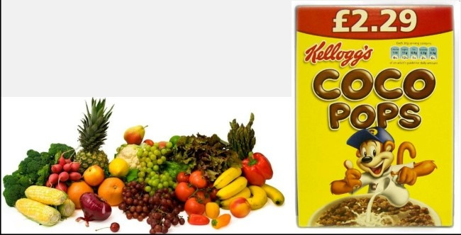
2. To promote healthy food
• Healthy food code of good
practice
• Manage proliferation of fast-
food outlets in certain areas e.g. outside schools
• Restrictions on advertising of
unhealthy foods to children

Slide 16


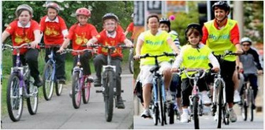
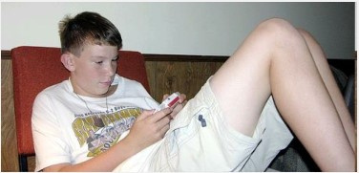
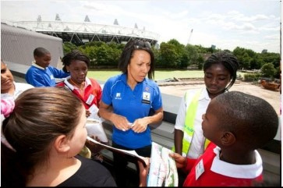

3. To build physical activity into our lives
• Invest in ‘walking into
health’ campaign
• Healthy Towns – EPODE
model
http://www.thecarolinewalkertrust.org.uk/pdfs/Ev2008_carolynSummerbell.pdf
• Entertainment technology
industry – manage sedentary time in children
• Review approach to
physical activity and sport with 2012 legacy
• Whole systems approach

Slide 17



4. To promote health at work
•
work with employers & employer
organisations to develop pilots - how companies can best promote wellness among their staff & make healthy workplaces part of their core business model
• Wellbeing assessments for NHS
employees
• Explore financial incentives to
encourage healthy living

Slide 18

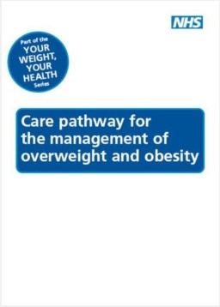
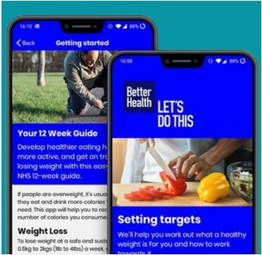
5. To provide effective treatment and support for those with obesity
• NHS Choices website to provide
personalised advice on diet, activity and healthy weight
• Commission more weight management
services through extra funding

Slide 19
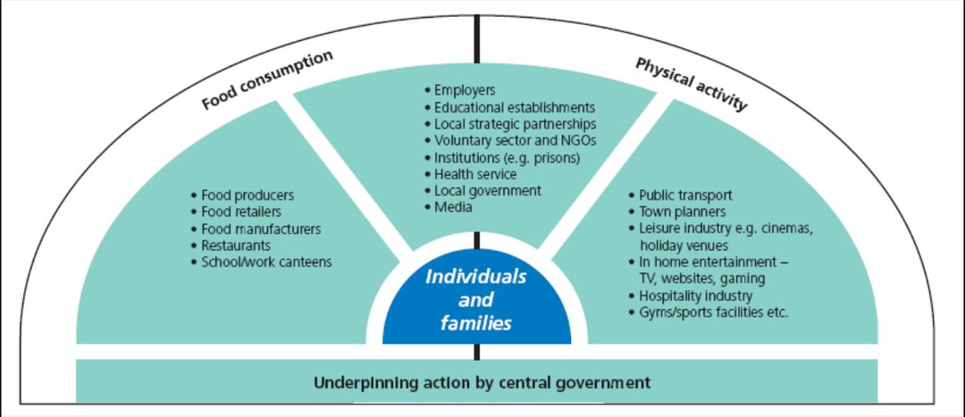
Map of major sectors that must play a role in tackling excess weight

Slide 20

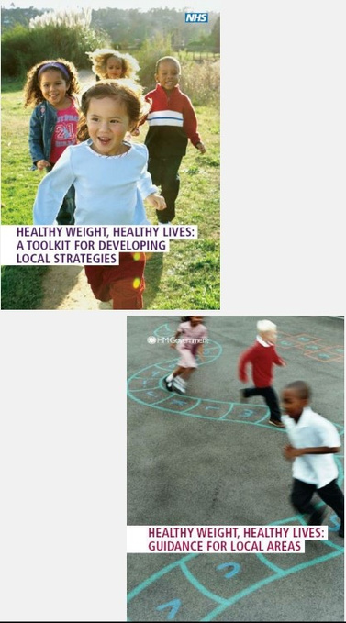


HWHL additional resources and reports

Slide 21

Healthy Lives, Healthy People
• Public health strategy for England
• November 2010
• Shift in how public health
challenges are tackled
• Obesity part of wider public health
issues
• Plan to make local government
and local at the heart of improving
health
• New integrated service–Public
Health England
• Work through Responsibility Deal
on food, alcohol, PA, health at
work & behaviour change
Introduction of Change4Life
•

Slide 22
2009 – Change4Life
Launched as England’s first national social marketing campaign to reduce obesity.
Built partly on HWHL goals; prevention‑oriented, focusing on changing lifestyles, diet and activity at family level.
Target audience: families with children under 11 (expanded in later years).

Slide 23

Healthy Lives, Healthy People – a call to action on obesity in England
• New national ambitions
– a sustained downward
national trend in the level of excess weight in children by 2020
– a downward trend in the
level of excess weight
averaged across all adults
by 2020
October 2011

Slide 24


Voluntary pledges from food industry to reduce portion sizes, energy, total fat, saturated fat, sugar and salt in food products; front of pack labelling; out of home
calorie labelling
https://www.gov.uk/government/news/public-health-responsibility-deal
https://www.sustainweb.org/reports/the_irresponsibility_deal/
Initiative quietly ‘parked’ at end of 2015 after govt. admitted it had no
‘teeth’ to fight powerful food lobby

Slide 25
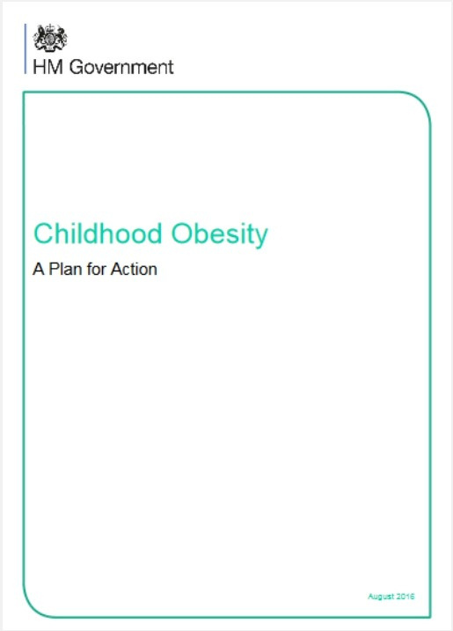
2016 UK Childhood Obesity Strategy
• Finally published in August
2016 after several delays and plenty of promises
• Only 13 pages in length
https://www.gov.uk/government/publications/childhood-obesity-a-plan-for-action

Slide 26
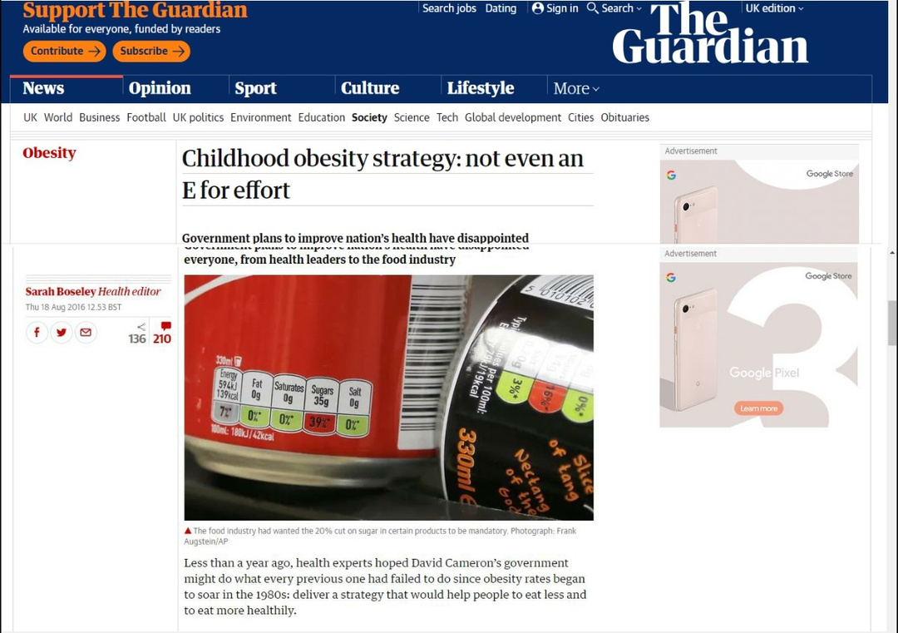
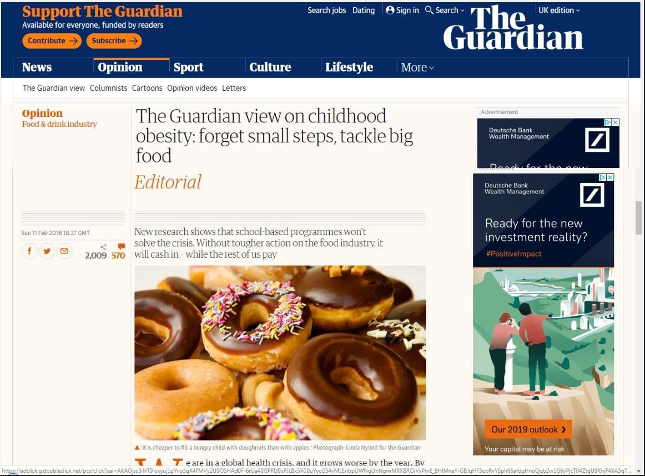
https://www.theguardian.com/society/2016/aug/18/childhood-obesity-strategy-not-even-an-e-for-effort
https://www.theguardian.com/commentisfree/2018/feb/11/the-guardian-view-on-childhood-obesity-forget-small-steps-tackle-big-food

Slide 27
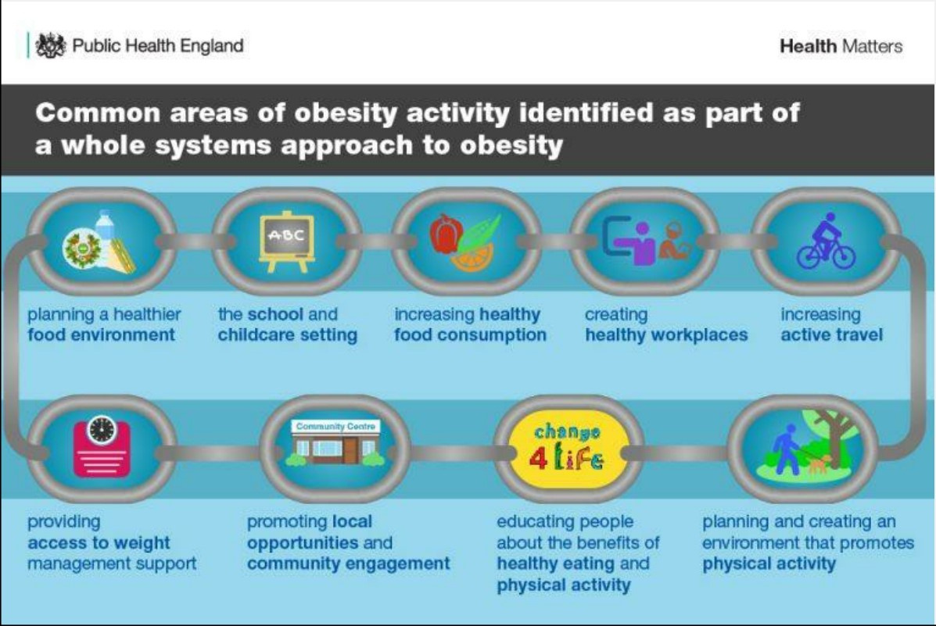

Slide 28
Brief Critique of Foresight/ HWHL
Focus on individual behaviour change
‘Softer’ options targeted
Voluntary codes of practice & easier to target behaviour change
Less targeting of upstream drivers (e.g. retailers, food industry, agriculture(
Little political will to take on food industry
Effectiveness of behaviour change?
++ food energy available within the food environment – greater energy consumption & waste
Increasing awareness of importance of environment vs. individual
? Political will to address ‘wicked’ problems

Slide 29

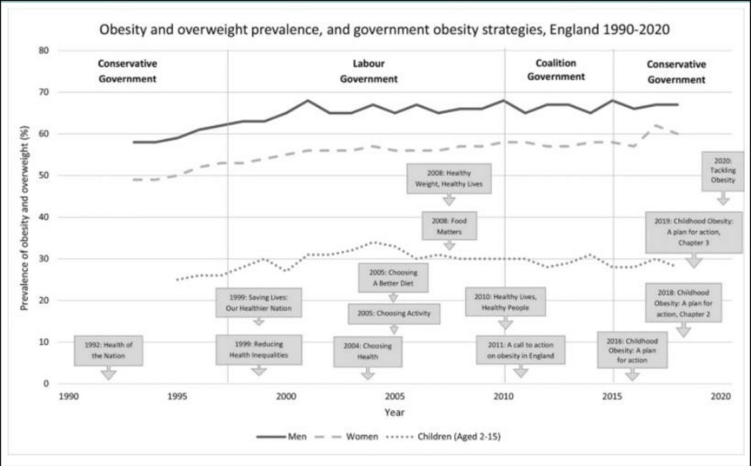
https://onlinelibrary.wiley.com/doi/10.1111/1468-0009.12498

Slide 30
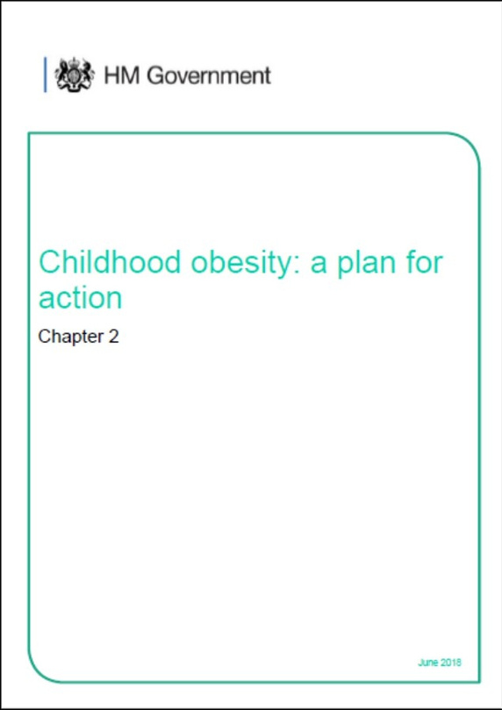
Published June 2018
Sets a national ambition to halve childhood obesity and significantly reduce the gap in obesity between children from the most and least
deprived areas by 2030
Achieved through:
sugar reduction calorie reduction advertising and promotions
local areas schools

Slide 31
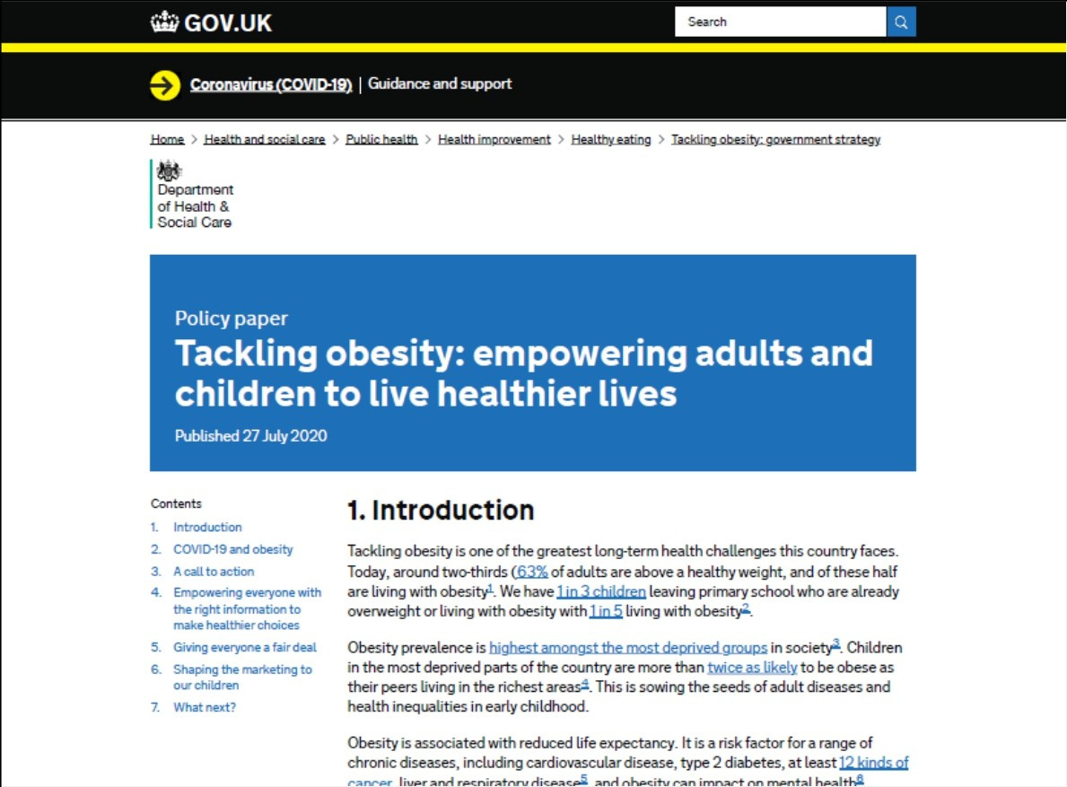
Published 27th July 2020

Slide 32
2024–2025 – Rising concern & new data
New NCMP data showed obesity prevalence in Reception and Year 6 remained high.
Increased disparities by ethnicity and deprivation.

Slide 33
2025 – New Government Prevention Measures
Restrictions on junk‑food advertising and high‑caffeine energy drinks.
Expansion of free school meals and universal free breakfast clubs.
Aim: reverse childhood obesity trends and reduce inequality gaps.

Slide 34

Local Use of HWHL Branding (Ongoing into 2022+)
Some councils (e.g., North Yorkshire) continue to use a Healthy Weight, Healthy Lives Strategy framework locally.
These local frameworks do not represent a continuation of the national HWHL strategy, but are adaptations.

Slide 35
Comparison: Healthy Weight, Healthy Lives (2008) vs. Current Policies (2025–26)
1. Strategic Focus:
Healthy Weight, Healthy Lives (2008)
Emphasis on reversing national obesity trends, focusing strongly on children.
Multi‑sector: schools, food industry, workplaces, NHS.
Prevention was important, but treatment/support also included.
Current Policies (2025–26)
Focus on preventing childhood obesity, reducing inequalities, and improving healthy environments (schools, advertising regulation).
Policies are more structural and regulatory than the 2008 strategy.
Government rhetoric emphasises not “looking away” as children become unhealthier.

Slide 36
2. Primary Targets
HWHL (2008)
Reduce childhood obesity to 2000 levels by 2020.
Address adult obesity through activity, food environment and workplace health.
2025–26 Policies
Reverse increasing obesity rates post‑pandemic, especially in early‑years and primary school children.
Close widening deprivation gaps in childhood obesity.
[gov.uk]

Slide 37
3. Methods of Intervention
HWHL (2008)
Behaviour change messaging.
Investment in early‑years programmes.
Encouraging physical activity through infrastructure (e.g., cycle lanes). [thensmc.com]
Current Strategies (2025–26)
Regulatory focus: limits on advertising of junk food, restrictions on high‑caffeine energy drinks.
School‑based nutrition interventions: expanded free school meals, universal breakfast clubs.
Tackling structural inequality. [gov.uk]

Slide 38
4. Governance & Implementation
HWHL (2008)
Strong cross‑government collaboration, with a formal strategy document.
Nationally coordinated and centrally funded. [data.parliament.uk], [navigator....lth.org.uk]
2025–26 Policies
Currently implemented through Department of Health and Social Care, NHS England, and Department for Education.
No single unified national obesity strategy branded like HWHL — more modular policy measures.

Slide 39
5. Status & Legacy
HWHL
No longer an active national strategy.
Ended after the 2008–2011 funding window.
Lives on in local frameworks and influenced later campaigns like Change4Life.
[navigator....lth.org.uk], [thensmc.com]
2025–26 Policies
Represent the current national response to obesity.
Stronger regulatory and inequality‑focused approaches. [gov.uk]

Slide 40
Aspect | HWHL (2008) | Current Policy (2025–26)
Type of strategy | Single unified national strategy | Set of policies; not a unified branded strategy
Focus | Childhood obesity, behaviour change, multisector action | Childhood obesity, inequality reduction, structural regulation
Approach | Education, partnerships, promotion | Regulation, school food expansion, targeted support
Status | Ended nationally after 2011 | Active & ongoing

Slide 41
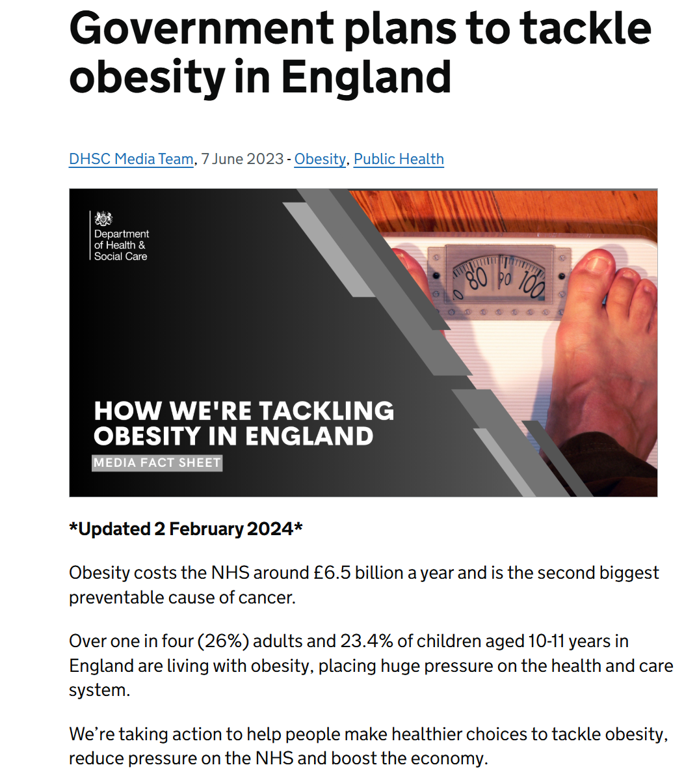
https://healthmedia.blog.gov.uk/2023/06/07/government-plans-to-tackle-obesity-in-england/

Slide 42
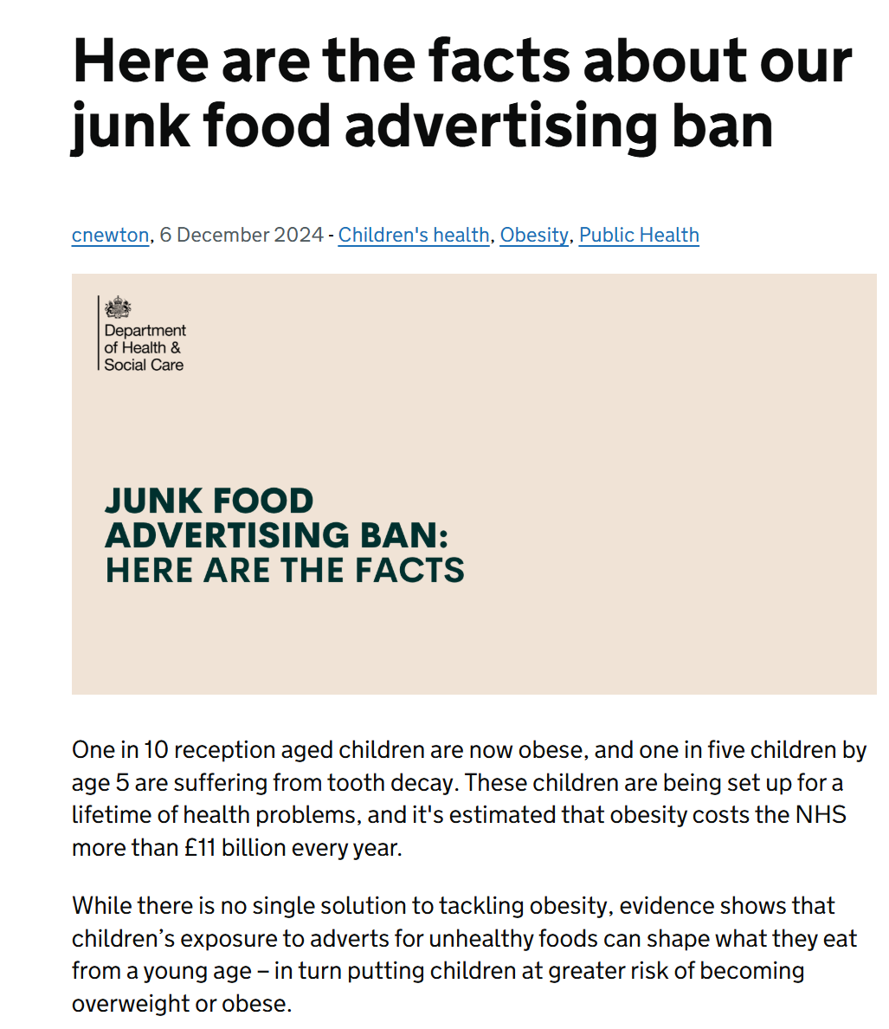
https://healthmedia.blog.gov.uk/2024/12/06/here-are-the-facts-about-our-junk-food-ban/

Slide 43
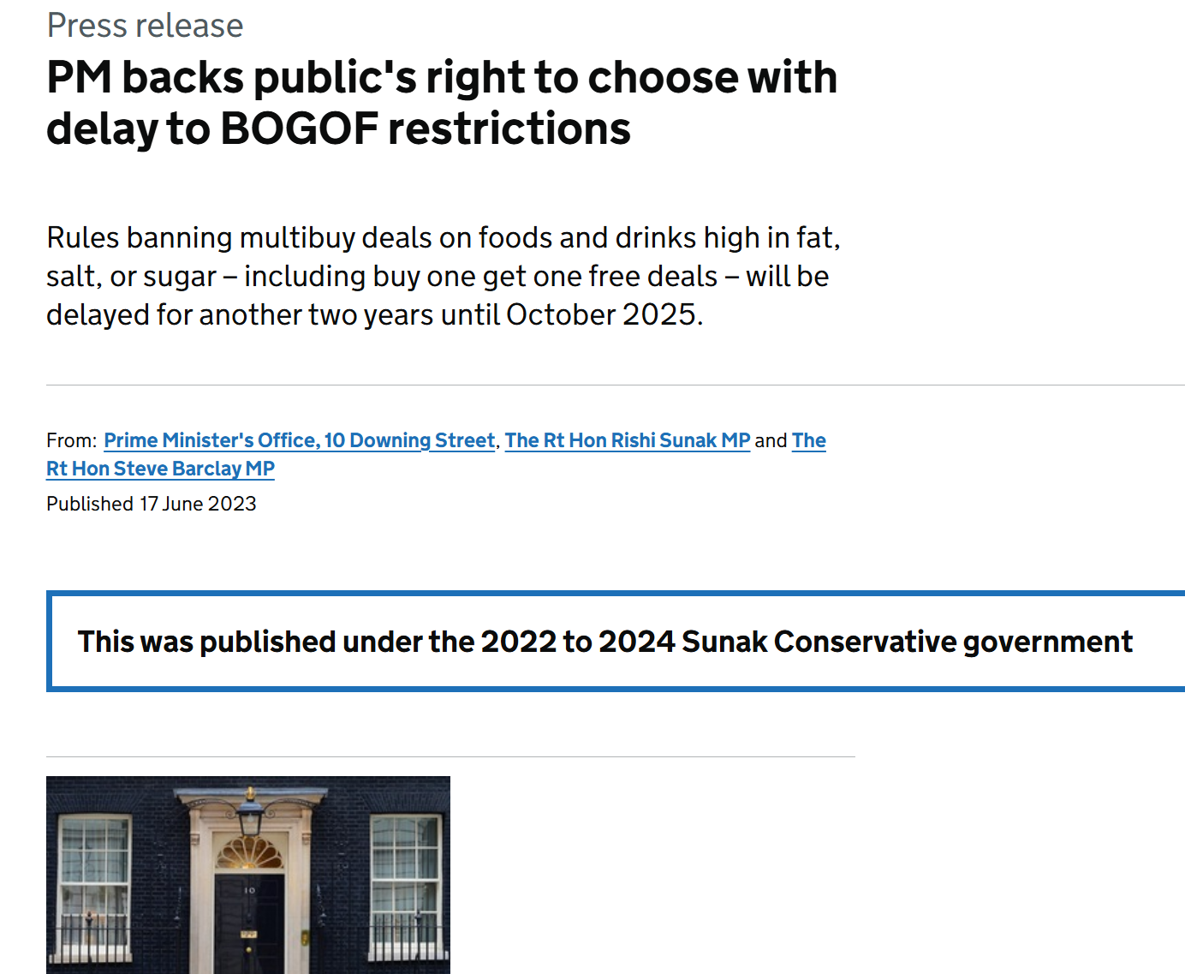
One third BOGOF on unhealthy products
https://foodfoundation.org.uk/press-release/one-third-bogof-and-multibuy-deals-are-unhealthy-food-just-38-fruit-and-veg

Slide 44
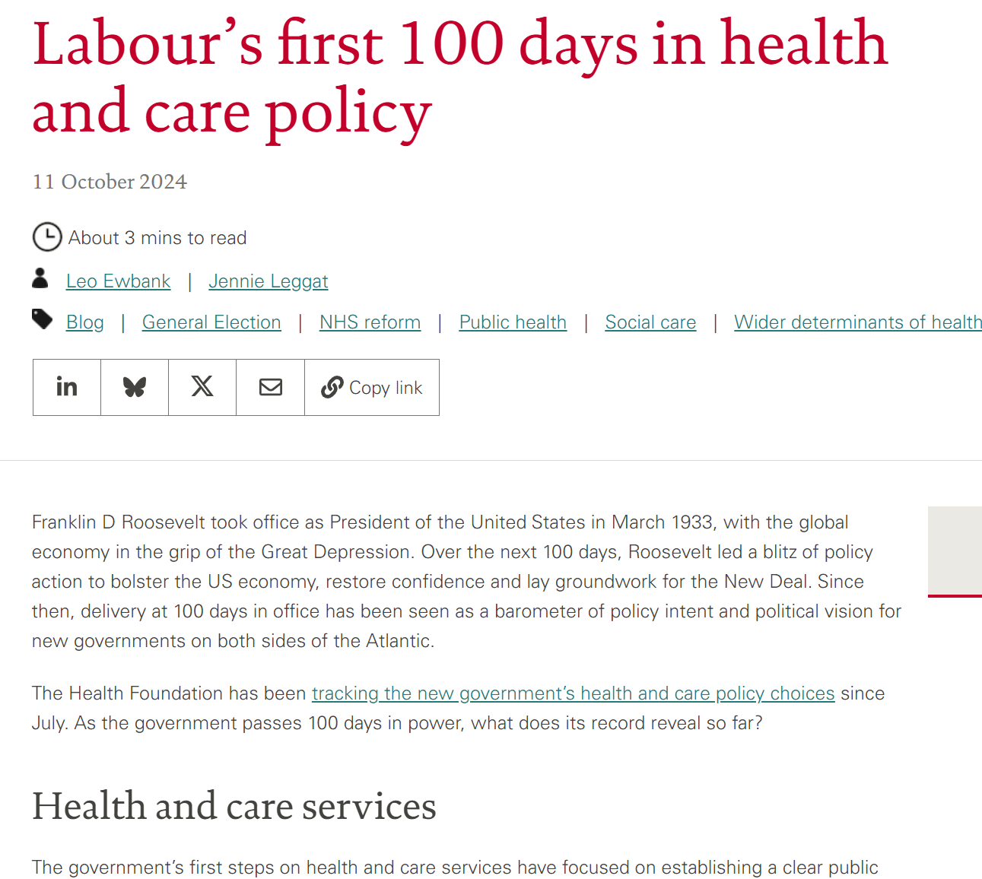
https://www.health.org.uk/features-and-opinion/blogs/labour-s-first-100-days-in-health-and-care-policy

Slide 45
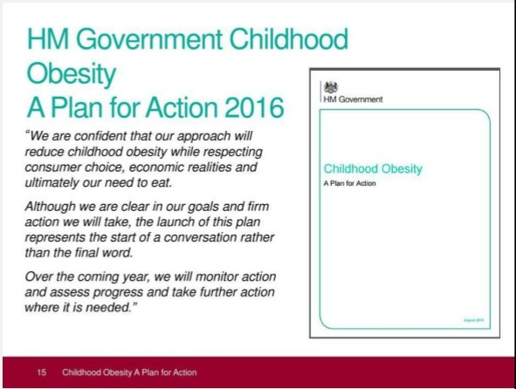
Summary, conclusions and evaluation
Obesity policy in the UK has
been in place for several years
Strong focus on individuals; traditionally less on the food system & physical environment
Evaluation focuses more on ‘soft’ targets than prevalence
No clear evidence of impact yet

